Slide 1

Author: Wang Guanheng

Slide 2
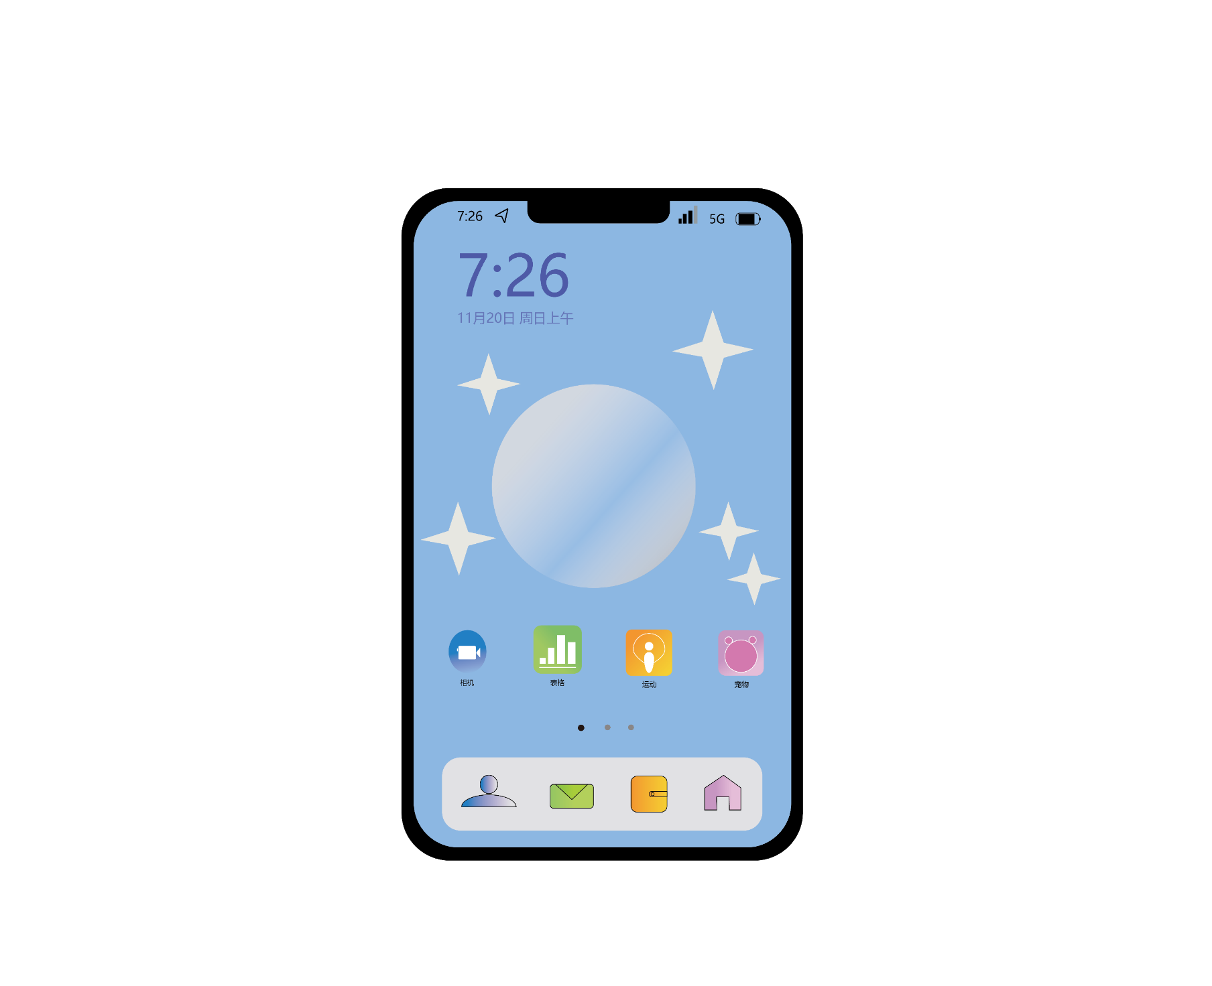

Graphic Design Works
These two works represent my graphic design portfolio. The one on the left showcases my resume, which is themed around Marine Science and Technology. The blue background and customized spray effect are combined with silver personal information, while the embellishment of light bulbs adds a touch of scientific and technological flair. On the right is an interface for a mobile application. The wallpaper section features a sky blue background adorned with gradient stars that twinkle, creating a dreamy atmosphere. The application itself utilizes a color gradient as its base color, complemented by concise icons to seamlessly blend in with the wallpaper.

Slide 3
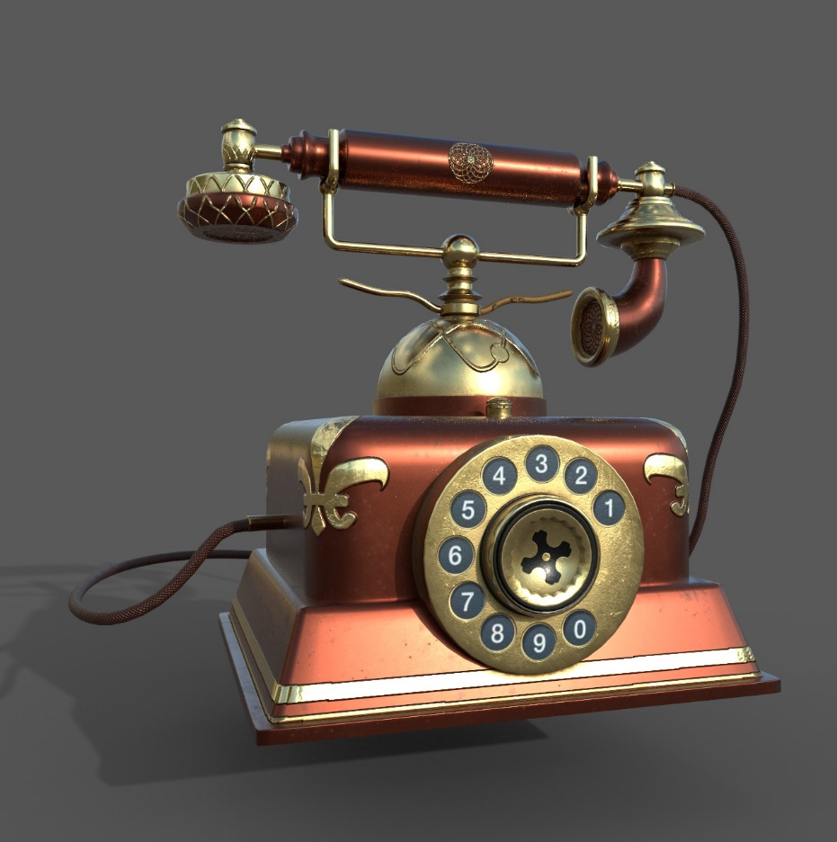
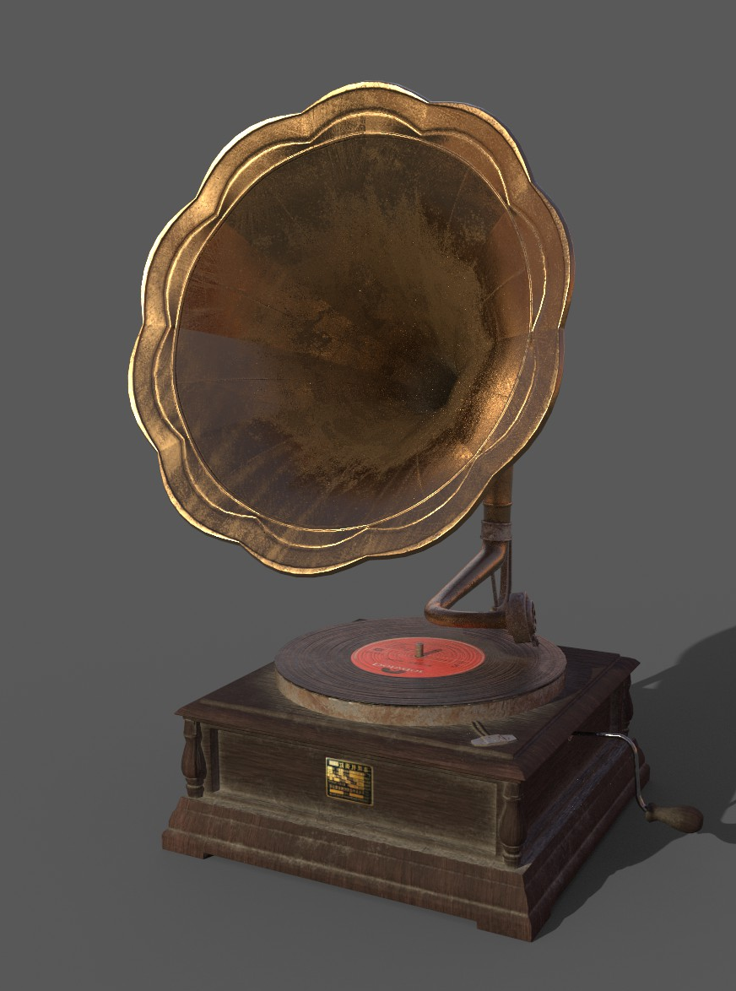
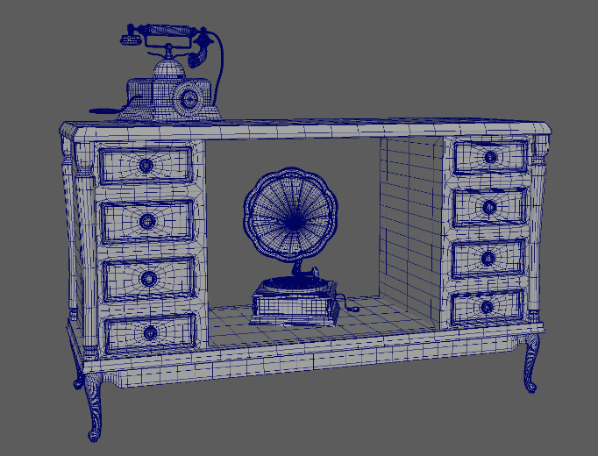
3D Prop Design Works
This is my original work during my study of 3D modeling, where I have designed retro phonographs and telephones through the process of creating cinematic visuals for the future era. The weathered appearance of the phonograph emphasizes its vintage charm, while the intricate gold patterns and vibrant red spray paint accentuate the opulent quality of the telephone.

Slide 4
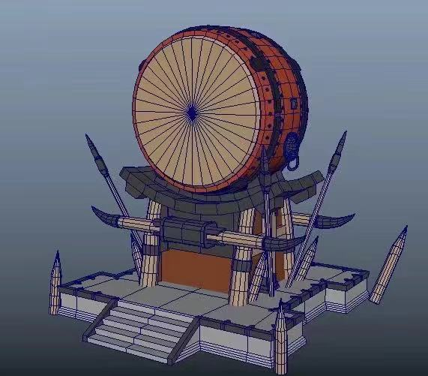
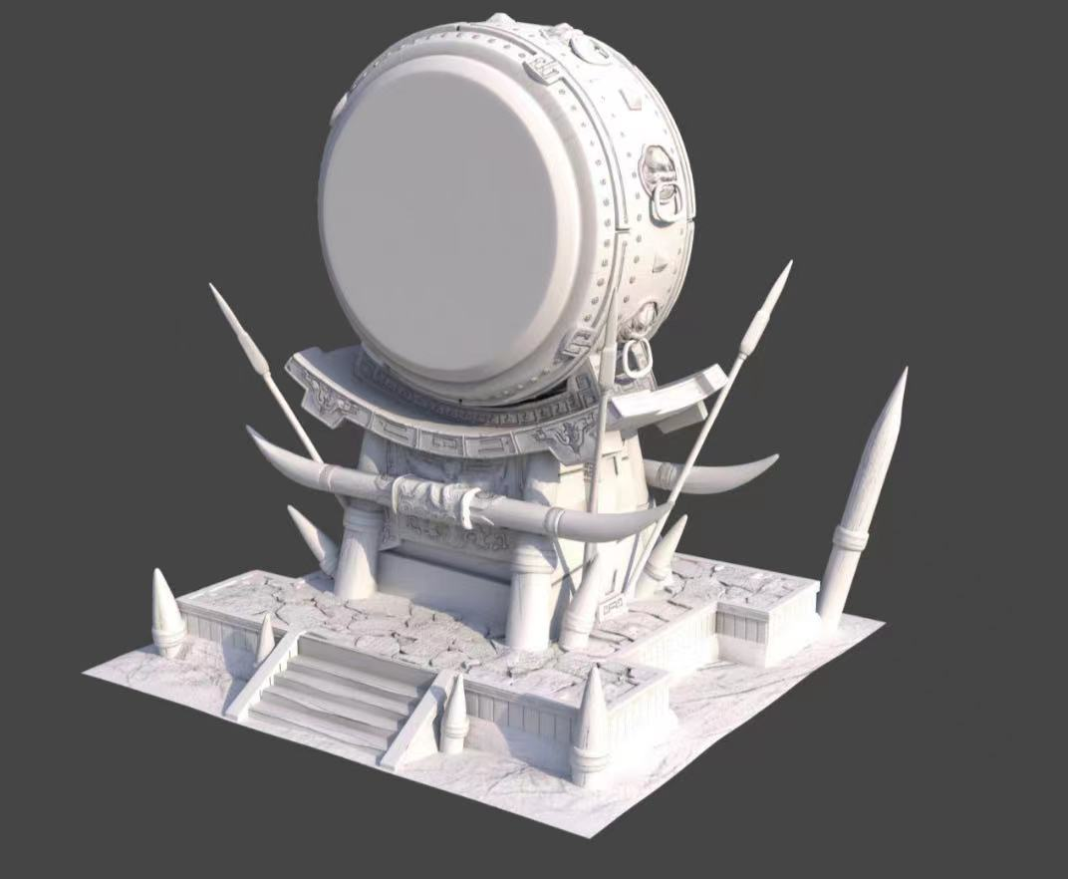
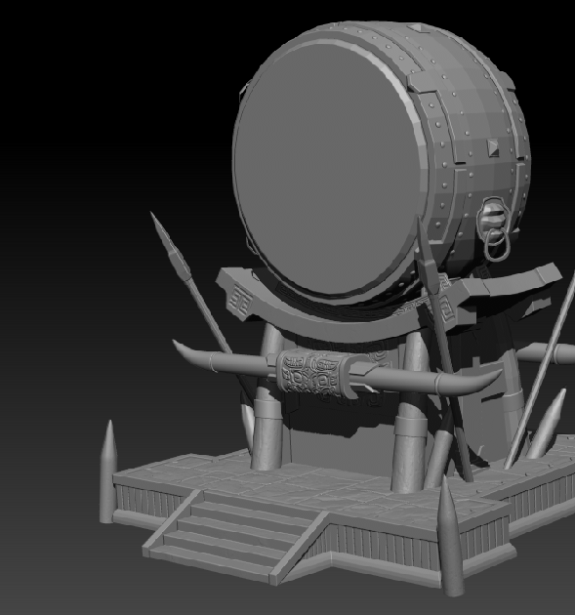
3D Prop Design Process
I utilize Maya to design the foundational structure of the drum, optimizing resource allocation for subsequent film or game production by eliminating superfluous and invisible surfaces that do not contribute to its volume. Subsequently, ZBrush's functional brush is employed to intricately depict the model's details, resulting in a more immersive and lifelike representation.

Slide 5
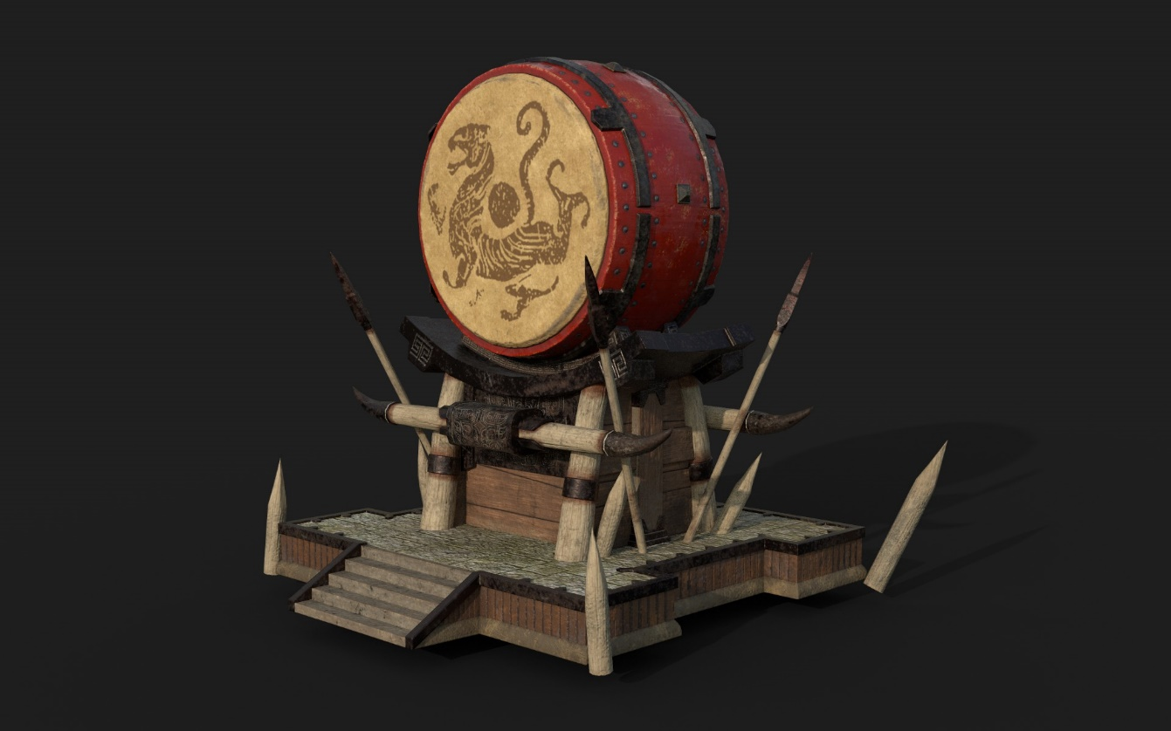
Achievement
After producing the high-quality model in ZBrush, further texturing and optimization are required. I utilize Substance Painter's material ball to apply a preliminary effect to the imported model map, then fine-tune it using various properties of the material ball until achieving my desired result. Finally, rendering is performed to obtain the final three-dimensional battle drum model.
Final Effect
3D Prop Design

Slide 6
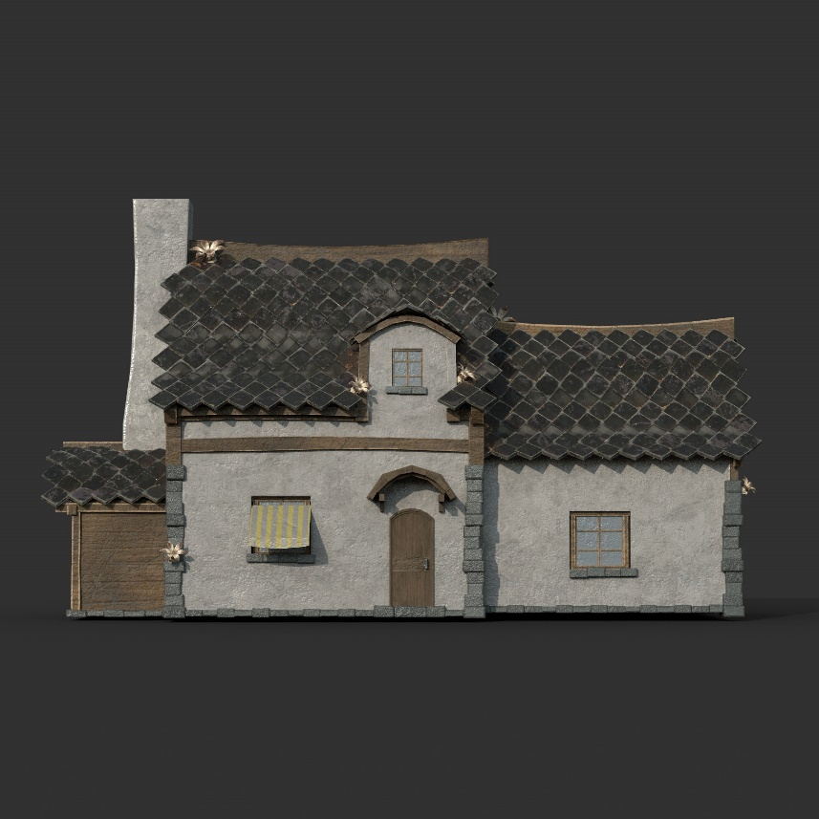
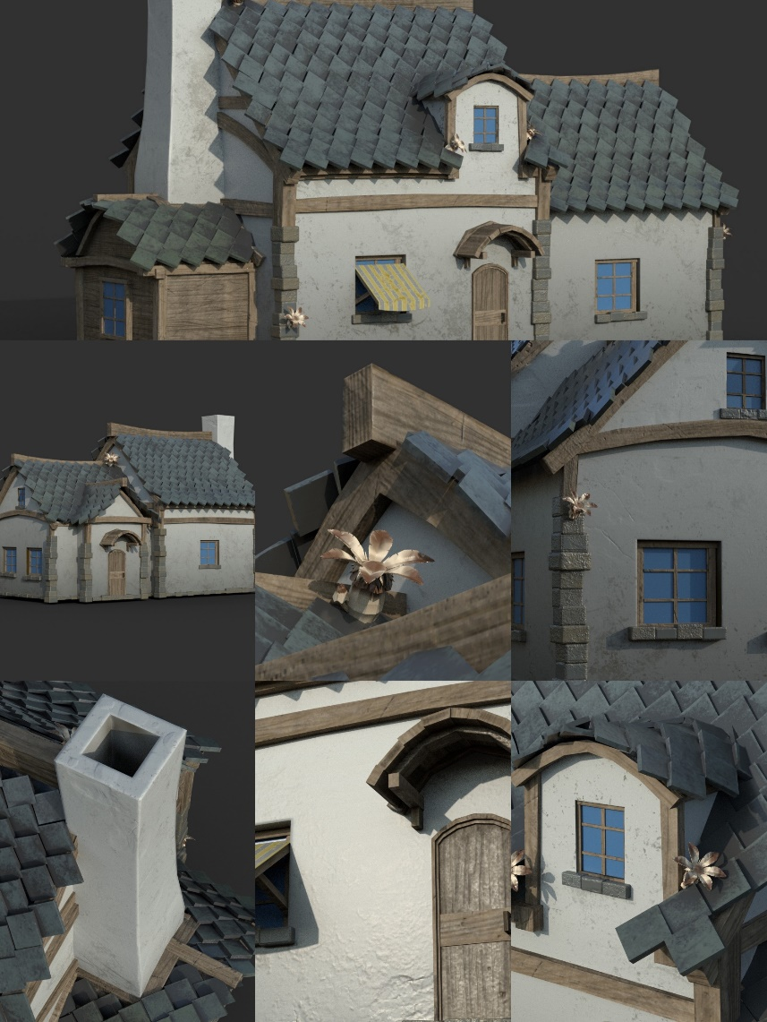
Final Effect
3D Design
Achievement
This is my four-week practical project, inspired by European medieval town houses and designed using three-dimensional production software to create vivid and realistic effects. These effects include the depiction of dilapidated walls, mushrooms growing on the eaves, and the intricate twists and turns of beams and tiles. By emphasizing a stylized approach, these elements were incorporated into an animation that ultimately won first prize at the university.

Slide 7
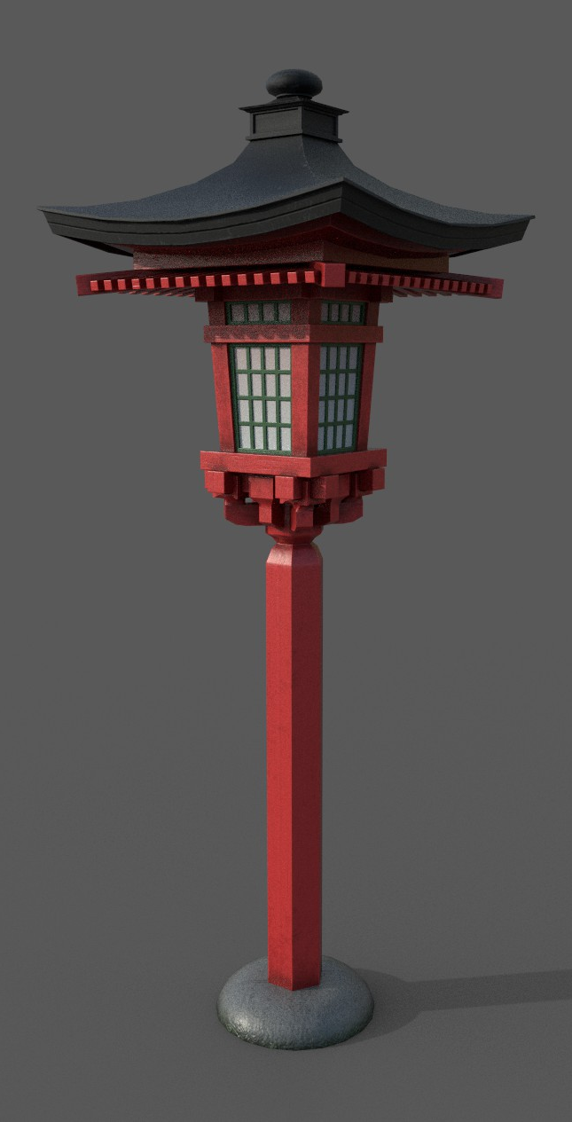
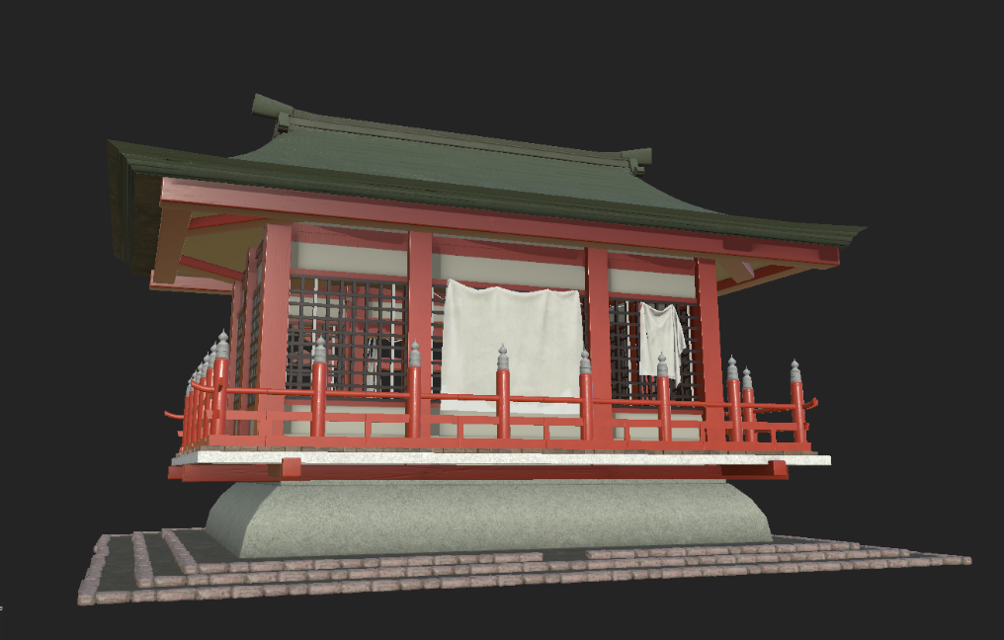
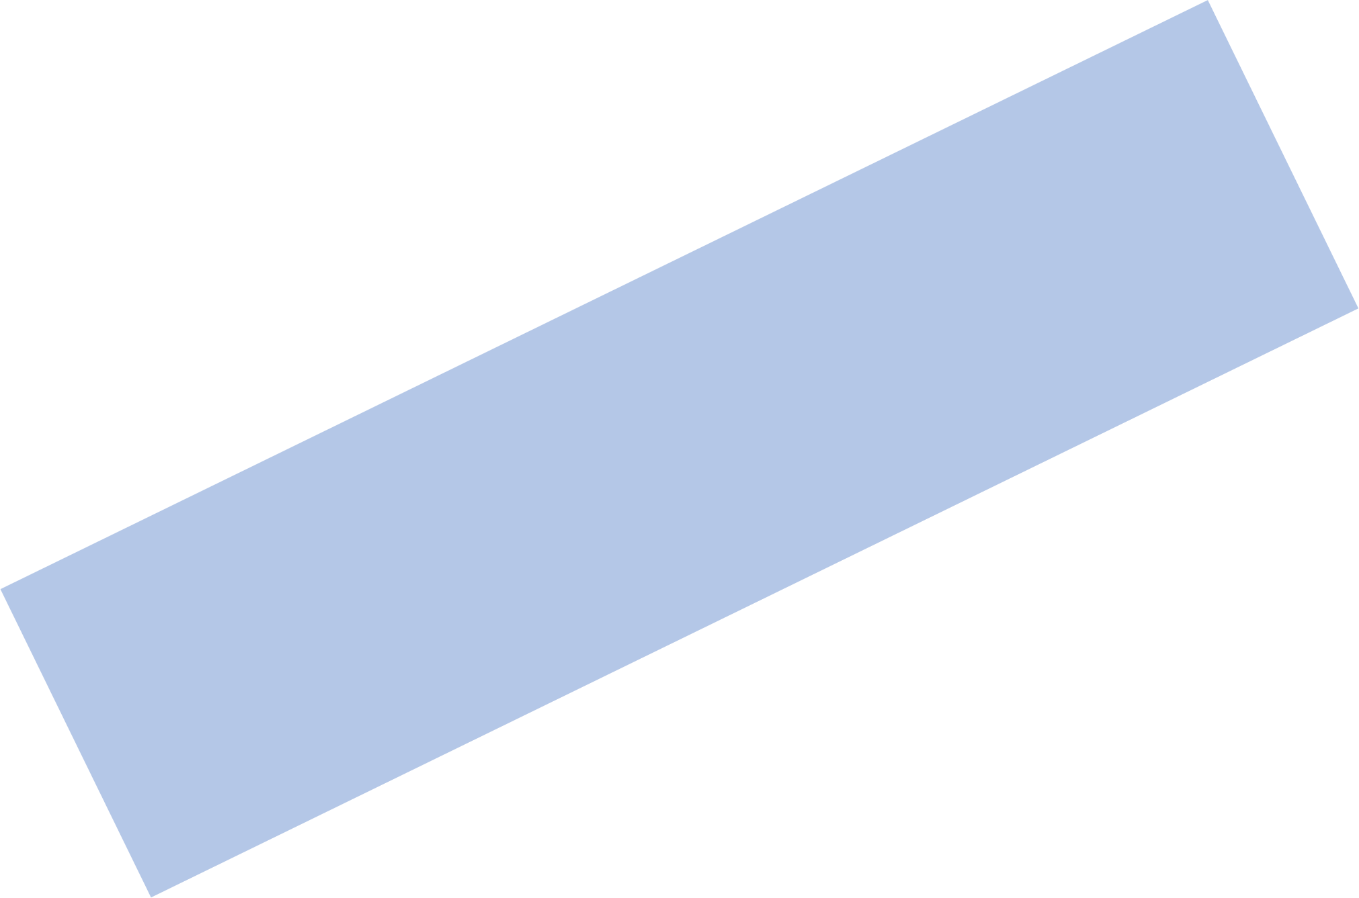
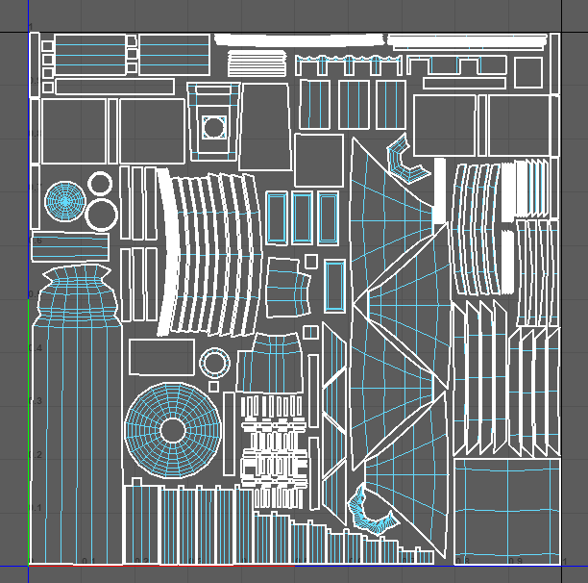
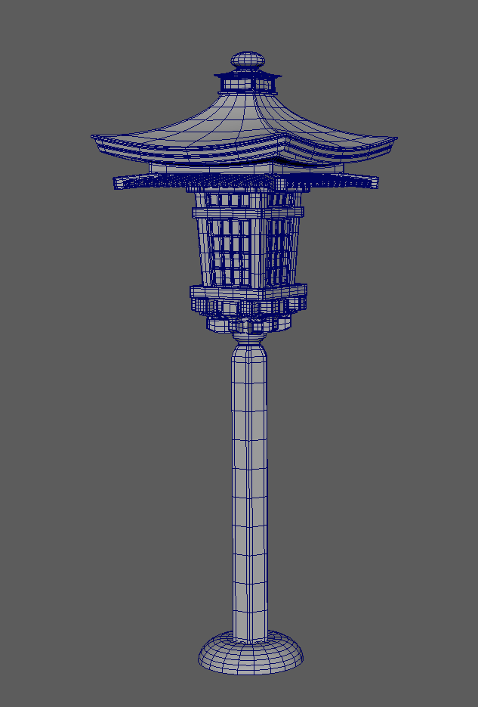
3D Prop Design
This is the 3D prop model I created for my graduation design, featuring a Japanese female samurai as the main character. The background decoration incorporates traditional Japanese lanterns and buildings to evoke an ancient and mysterious atmosphere. These prop models will be individually arranged into scenes, combined with mirrors, and complemented by the main character model to create a unique perspective of a Japanese shrine.

Slide 8
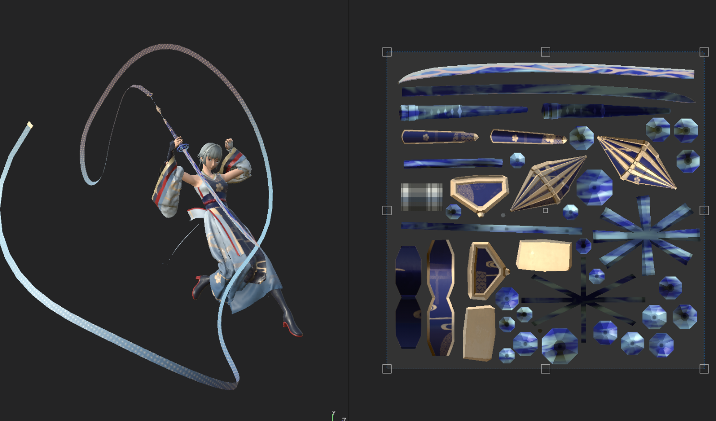
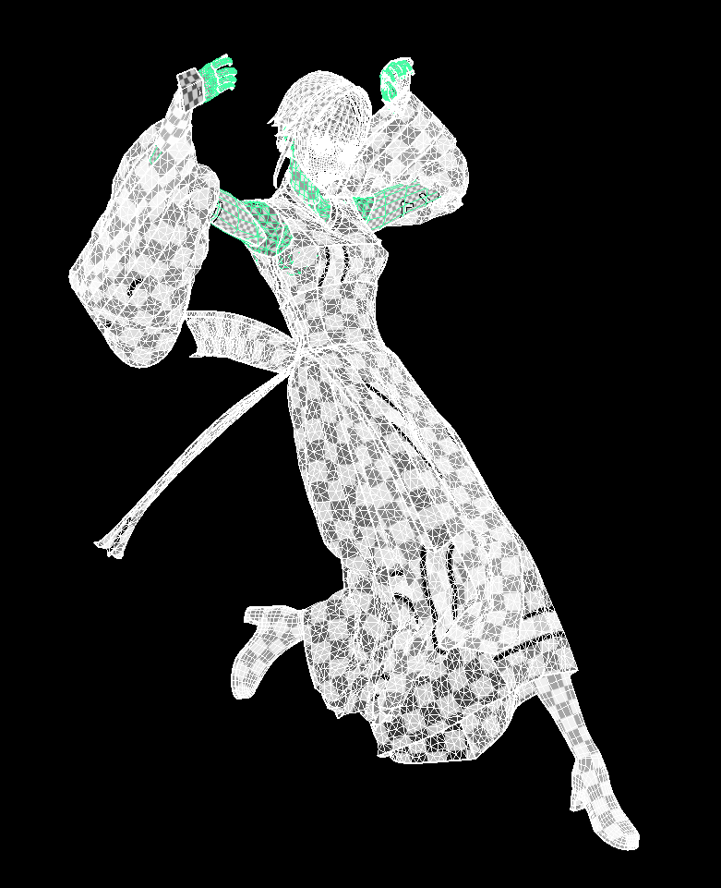
3D Role Design Process
Achievement
These images showcase the production process of the main character model in my graduation project. Utilizing Maya software's UV editor, I employed functions such as expansion and optimization to achieve an equal grid coverage effect by organizing the UVs. This approach ensures that subsequent models display mapping details accurately with consistent resolution, resulting in a visually appealing mapping effect.

Slide 9
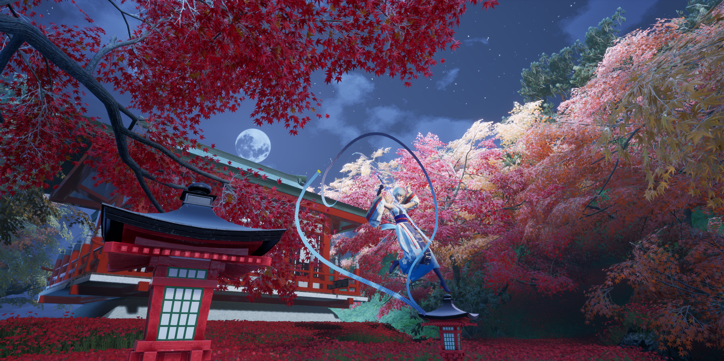
3D Role Design
Final Effect

Slide 10

Author: Wang Guanheng

